Slide 1
NEO-BIKE-RENTAL APPLICATION
Done by:
Goldy Jeyarani R
Preethi S
Akash S
Sivaprasad S

Slide 2
INTRODUCTION
The recent boom in the era of internet has ensured that all types of services, sales and products to be online. Business has become more efficient for both the business person and the customers. It is now fast, accessible from anywhere and anytime to avoid the hefty physical transactions. The project neo-bike-rental app keeping all these things in mind provides an efficient solution for the bike rental industry.
The idea behind the proposed website is to develop consistent, robust and user-friendly software that allows customers to rent any vehicle as per his/her requirements, for required duration and in any of the selected cities. This service will work round the clock thus will allow anyone to rent a bike in a city without any time restriction, board the bike at his choice of location, pay for the rental online and could also provide valuable feedback for improvement in services.

Slide 3
TECH STACK
Front-End
Angular
Bootstrap
HTML, Cascading Style Sheets
Java Script, TypeScript
Back-End
Spring Boot
Spring Web
Spring Security
Spring Hibernate
MySQL

Slide 4
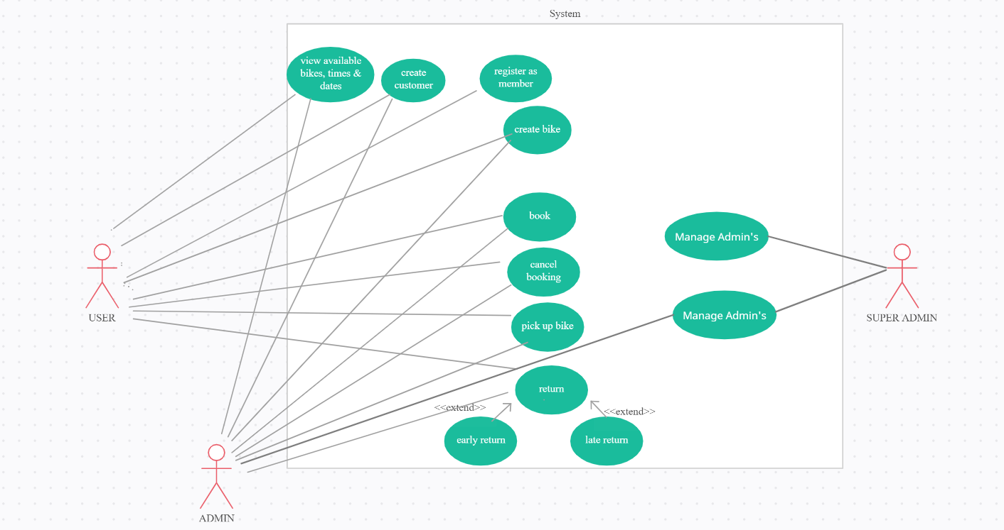
USE-CASE

Slide 5
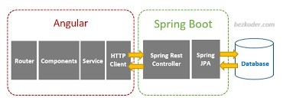
IMPORTANT COMPONENTS

Slide 6
SUPER ADMIN
Super Admin has the complete control to manage Admin’s and User’s.
Super Admin can view and delete any admin or user currently registered into the system.
Super Admin can also view and manage the bookings present in the system.

Slide 7
ADMIN
Admin has the overall control of the application with just the managing of other admins missing.
Admin can manage the user’s, company’s and bikes currently registered in the system.
Admin has the ability to view and edit the data’s in the system (where he can add or remove or modify the data).

Slide 8
USER
User is the actor in this system with the least control.
He can manage only his data.
User can book the bike with his own timeline without any restrictions.
User can also add bikes and modify only that data.

